Slide 1
[320] Reproducibility 2
Yiyin Shen

Slide 2

Discuss: how might we define "reproducibility" for a data scientist?

Slide 3
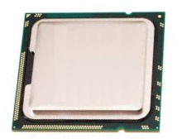
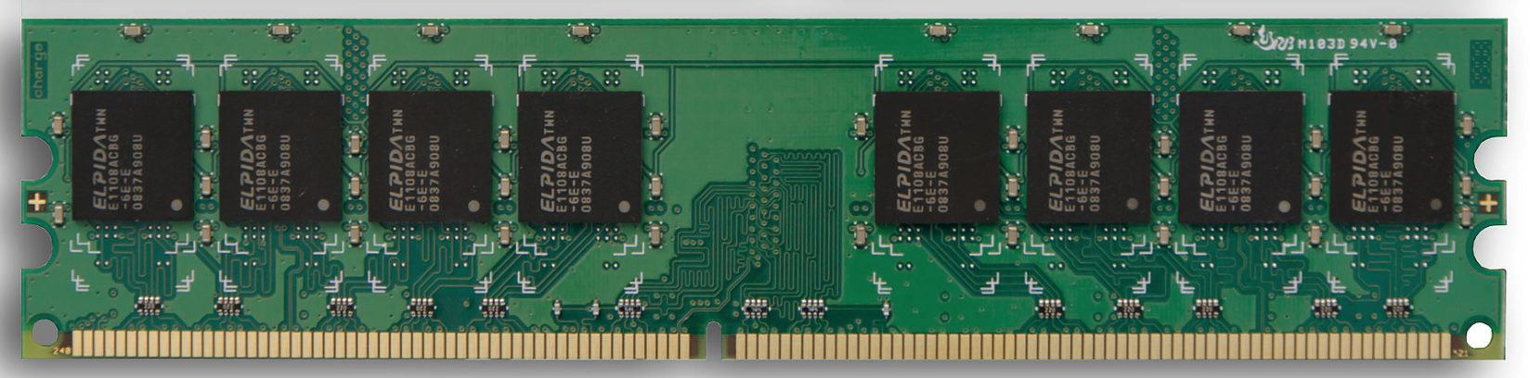
Big question: will my program run on someone else's computer? (not necessarily written in Python)
Things to match:
CPU
1
Hardware
2
Operating System
3
Dependencies

Slide 4
Hardware: Mental Model of Process Memory
Imagine...
one huge list, per each running program process, called "address space"
every entry in the list is an integer between 0 and 255 (aka a "byte")
values (bytes)
0
0
0
0
0
0
0
0
0
0
0
0
0
0
0
0
...
0
1
2
3
4
5
6
7
8
9
10
11
12
13
14
15
indexes (aka "addresses")

Slide 5
How can we use one giant list to handle the following?
multiple lists
variables and other references
strings
code
data
0
0
0
0
0
0
0
0
0
0
0
0
0
0
0
0
...
0
1
2
3
4
5
6
7
8
9
10
11
12
13
14
15
Is this really all we have for state?

Slide 6
How can we use one giant list to handle the following?
multiple lists
variables and other references
strings
code
0
0
0
0
0
0
0
0
3
20
0
0
11
22
33
0
...
0
1
2
3
4
5
6
7
8
9
10
11
12
13
14
15
the [3,20] list starts at index address 8 in the giant list
the [11,22,33] list starts at address 12 in the giant list

Slide 7
How can we use one giant list to handle the following?
multiple lists
variables and other references
strings
code
0
0
0
0
0
0
0
0
3
20
0
0
11
22
33
0
...
0
1
2
3
4
5
6
7
8
9
10
11
12
13
14
15
# fast
L2.append(44)
implications for performance...

Slide 8
How can we use one giant list to handle the following?
multiple lists
variables and other references
strings
code
0
0
0
0
0
0
0
0
3
20
0
0
11
22
33
44
...
0
1
2
3
4
5
6
7
8
9
10
11
12
13
14
15
# fast
L2.append(44)
implications for performance...

Slide 9
How can we use one giant list to handle the following?
multiple lists
variables and other references
strings
code
0
0
0
0
0
0
0
0
3
20
0
0
11
22
33
44
...
0
1
2
3
4
5
6
7
8
9
10
11
12
13
14
15
# fast
L2.append(44)
# slow
L2.pop(0)
implications for performance...

Slide 10
How can we use one giant list to handle the following?
multiple lists
variables and other references
strings
code
0
0
0
0
0
0
0
0
3
20
0
0
22
33
44
...
0
1
2
3
4
5
6
7
8
9
10
11
12
13
14
15
# fast
L2.append(44)
# slow
L2.pop(0)
implications for performance...

Slide 11
How can we use one giant list to handle the following?
multiple lists
variables and other references
strings
code
0
0
0
0
0
0
0
0
3
20
0
0
22
33
44
0
...
0
1
2
3
4
5
6
7
8
9
10
11
12
13
14
15
# fast
L2.append(44)
# slow
L2.pop(0)
We'll think more rigorously about
performance in CS 320 (big-O notation)

Slide 12
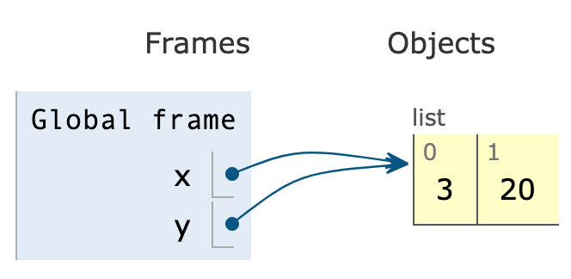
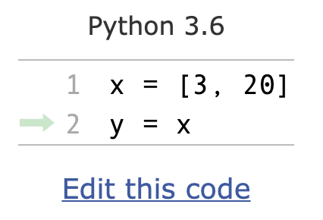
How can we use one giant list to handle the following?
multiple lists
variables and other references
strings
code
the x variable is at address 3
the y variable is at address 5
0
0
0
8
0
8
0
0
3
20
0
0
0
0
0
0
...
0
1
2
3
4
5
6
7
8
9
10
11
12
13
14
15
PythonTutor's visualization

Slide 13
How can we use one giant list to handle the following?
multiple lists
variables and other references
strings
code
discuss: how?
0
0
0
0
0
0
0
0
0
0
0
0
0
0
0
0
...
0
1
2
3
4
5
6
7
8
9
10
11
12
13
14
15
Is this really all we have for state?

Slide 14
How can we use one giant list to handle the following?
multiple lists
variables and other references
strings
code
???
0
0
0
0
0
0
0
0
0
0
0
0
0
67
65
66
...
0
1
2
3
4
5
6
7
8
9
10
11
12
13
14
15
code
65
66
67
68
...
letter
A
B
C
D
...
encoding:
f = open("file.txt", encoding="utf-8")

Slide 15
How can we use one giant list to handle the following?
multiple lists
variables and other references
strings
code
"CAB"
0
0
0
0
0
0
0
0
0
0
0
0
0
67
65
66
...
0
1
2
3
4
5
6
7
8
9
10
11
12
13
14
15
code
65
66
67
68
...
letter
A
B
C
D
...
encoding:
f = open("file.txt", encoding="utf-8")

Slide 16
How can we use one giant list to handle the following?
multiple lists
variables and other references
strings
code
i = 0
while ????:
i += 2
# what line next?
operands
operator
0
0
0
0
0
0
0
0
...
...
5
4
2
33
10
0
...
0
1
2
3
4
5
6
7
8
9
10
11
12
13
14
15
code
5
8
33
...
operation
ADD
SUB
JUMP
...
Instruction Set
Notes:
f22: section 1

Slide 17
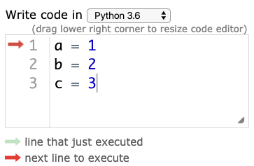

Hardware: Mental Model of CPU
CPUs interact with memory:
keep track of what instruction we're on
understand instruction codes
much more
CPU
0
0
0
0
0
0
0
0
...
...
5
4
2
33
10
0
...
0
1
2
3
4
5
6
7
8
9
10
11
12
13
14
15
code
5
8
33
...
operation
ADD
SUB
JUMP
...
Instruction Set

Slide 18
Hardware: Mental Model of CPU
CPUs interact with memory:
keep track of what instruction we're on
understand instruction codes
much more
CPU
add 2 to variable
0
0
0
0
2
0
0
0
...
...
5
4
2
33
10
0
...
0
1
2
3
4
5
6
7
8
9
10
11
12
13
14
15
code
5
8
33
...
operation
ADD
SUB
JUMP
...
Instruction Set

Slide 19
Hardware: Mental Model of CPU
CPUs interact with memory:
keep track of what instruction we're on
understand instruction codes
much more
CPU
go back to top of loop
0
0
0
0
2
0
0
0
...
...
5
4
2
33
10
0
...
0
1
2
3
4
5
6
7
8
9
10
11
12
13
14
15
code
5
8
33
...
operation
ADD
SUB
JUMP
...
Instruction Set

Slide 20
Hardware: Mental Model of CPU
CPUs interact with memory:
keep track of what instruction we're on
understand instruction codes
much more
CPU
0
0
0
0
2
0
0
0
...
...
5
4
2
33
10
0
...
0
1
2
3
4
5
6
7
8
9
10
11
12
13
14
15
code
5
8
33
...
operation
ADD
SUB
JUMP
...
Instruction Set

Slide 21
Hardware: Mental Model of CPU
discuss: what would happen if a CPU tried to execute an instruction for a different CPU?
0
0
0
0
0
0
0
0
...
...
5
4
2
33
10
0
...
0
1
2
3
4
5
6
7
8
9
10
11
12
13
14
15
code
5
8
33
...
operation
ADD
SUB
JUMP
...
code
5
8
33
...
operation
SUB
ADD
undefined
...
Instruction Set
for CPU X
Instruction Set
for CPU Y
Notes:
s22: lec 1+2 ended here

Slide 22
Hardware: Mental Model of CPU
a CPU can only run programs that use instructions it understands!
CPU Y
0
0
0
0
0
0
0
0
...
...
5
4
2
33
10
0
...
0
1
2
3
4
5
6
7
8
9
10
11
12
13
14
15
code
5
8
33
...
operation
ADD
SUB
JUMP
...
code
5
8
33
...
operation
SUB
ADD
undefined
...
Instruction Set
for CPU X
Instruction Set
for CPU Y

Slide 23
A Program and CPU need to "fit"
Program A
Program B
CPU X
CPU Y
Program B
Program A
CPU X
CPU Y

Slide 24
A Program and CPU need to "fit"
Program A
Program B
CPU X
CPU Y
why haven't we noticed this yet for our Python programs?

Slide 25
Interpreters
program.py
same
program.py
python code
python.exe (X)
python.exe (Y)
different
machine code
CPU X
CPU Y
different
Interpreters (such as python.exe) make it easier to run the same code on different machines
A compiler is another tool for running the same code on different CPUs

Slide 26
Interpreters
program.py
same
program.py
python code
python.exe (X)
different
python.exe (Y)
machine code
CPU X
different
CPU Y
Interpreters (such as python.exe) make it easier to run the same code on different machines
Discuss: if all CPUs had the instruction set,
would we still need a Python interpreter?

Slide 27
Big question: will my program run on someone else's computer? (not necessarily written in Python)
Things to match:
1
many others...
Hardware
2
Operating System
3
Dependencies
[this semester]

Slide 28
OS jobs: Allocate and Abstract Resources
[like CPU, hard drive, etc]
1
2
Allocation
Abstraction
Process B
f = open("file.txt")
data = f.read()
f.close()
waiting
...
Process Z
convenient
OS decides
Operating System
running
Process A
inconvenient
CPU X
only one process can run on CPU at a time (or a few things if the CPU has multiple "cores")
ignorant of
files/directories

Slide 29
Harder to reproduce on different OS...
bad.py
Python Interpreter
f = open("/data/file.txt")
...
Windows
CPU X
The Python interpreter mostly lets you
[Python Programmer] ignore the CPU you run on.
But you still need to work a bit to "fit" the code to the OS.

Slide 30
Harder to reproduce on different OS...
good.py
Python Interpreter
f = open("c:\data\file.txt")
...
Windows
CPU X
The Python interpreter mostly lets you
[Python Programmer] ignore the CPU you run on.
But you still need to work a bit to "fit" the code to the OS.

Slide 31
Harder to reproduce on different OS...
good.py
# solution 1:
f = open(os.path.join("data", "file.txt"))
...
Python Interpreter
Windows
# solution 2:
tell anybody reproducing your results to use the same OS!
CPU X
tradeoffs?
The Python interpreter mostly lets you
[Python Programmer] ignore the CPU you run on.
But you still need to work a bit to "fit" the code to the OS.

Slide 32

VMs (Virtual Machines)
popular virtual
machine software
Mac OS X
Programs
programs
programs
Linux OS
Windows OS
Virtual Machine
Virtual Machine
programs
Mac Operating System
Physical Machine
[CPU, memory, etc]
With the right virtual machines created and operating systems installed, you could run programs for Mac, Linux, and Windows -- at the same time without rebooting!

Slide 33

The Cloud
popular cloud providers
cloud providers let you rent VMs in the cloud on hourly basis (e.g., $15 / month)
Linux
here
VM
VM
VM
VM
remote connection
ssh session>
Windows, Mac, whatever
we'll use GCP virtual machines this semester
[setup in lab]
run in PowerShell/bash to access CS lab
ssh user@best-linux.cs.wisc.edu
https://docs.microsoft.com/en-us/windows-server/administration/openssh/openssh_install_firstuse

Slide 34
Lecture Recap: Reproducibility
Big question: will my program run on someone else's computer?
Things to match:
1
a program must fit the CPU;
python.exe will do this, so
program.py won't have to
Hardware
2
we'll use Ubuntu Linux on
virtual machines in the cloud
Operating System
3
Dependencies
today: versioning

Slide 35
Recap of 15 new terms
reproducibility: others can run our analysis code and get same results
process: a running program
byte: integer between 0 and 255
address space: a big "list" of bytes, per process, for all state
address: index in the big list
encoding: pairing of letters characters with numeric codes
CPU: chip that executes instructions, tracks position in code
instruction set: pairing of CPU instructions/ops with numeric codes
operating system: software that allocates+abstracts resources
resource: time on CPU, space in memory, space on SSD, etc
allocation: the giving of a resource to a process
abstraction: hiding inconvenient details with something easier to use
virtual machine: "fake" machine running on real physical machine virtual machine: allows us to run additional operating systems
cloud: place where you can rent virtual machines and other services
ssh: secure shell -- tool that lets you remotely access another machine

Slide 36
[320] Version Control (git)
Yiyin Shen

Slide 37
Reproducibility
Big question: will my program run on someone else's computer?
Things to match:
1
a program must fit the CPU;
python.exe will do this, so
program.py won't have to
Hardware
2
we'll use Ubuntu Linux on
virtual machines in the cloud
Operating System
3
Dependencies
today: versioning

Slide 38
Dependency Versions
this program "depends" on pandas
program.py
import os, sys, json
import pandas
import pandas
print("Pandas Version:", pandas.__version__)
# code that uses pandas
you can check a
module version
behavior depends on which release was installed
pip install pandas
or
pip install pandas==0.25.1
or
pip install pandas==0.24.0
or...

Slide 39
Versioning: motivation and basic concepts

Slide 40
Many tools auto-track history (e.g., Google Docs)
when
it changed
what
changed
who
changed it
https://zapier.com/apps/google-docs/tutorials/google-docs-revision-history

Slide 41
Version Control Systems (VCS)
Useful for many kinds of projects
code, papers, websites, etc
manages all files for same project (maybe thousands) in a repository
Explicit snapshots/checkpoints, called commits
users manually run commands to preserve good versions
Explicit commit messages
who, what, when, why
Work can branch out and be merged back
people can work offline
can get feedback before merging
humans need to resolve conflicts when versions being merged are too different
partner A working on hw.py at school
partner B also working on hw.py, without wifi
what happens when the plane lands?

Slide 42
Example
add file
edit file
edit+add
hello.py
hello.py
hello.py
print("hi")
print("hello")
print("world")
import dog
dog.bark()
commits:
dog.py
def bark():
print("bark"*10)
time
at any point in time,
you just see one version
of the files on your computer

Slide 43
Use case 1: troubleshooting discovered bug
commit 1
msg: first version
author: Yiyin
commit 2
msg: upgrade light
author: Yiyin
commit 3
msg: save energy
author: Victor
time
bug introduced
along with feature
somebody notices
bug after commit 3
who will get blamed?

Slide 44
Use case 1: troubleshooting discovered bug
test.py:
test.py:
test.py:
commit 1
msg: first version
author: Yiyin
commit 2
msg: upgrade light
author: Yiyin
commit 3
msg: save energy
author: Victor
time
bug introduced
along with feature
somebody notices
bug after commit 3

Slide 45
Use case 1: troubleshooting discovered bug
test.py:
test.py:
test.py:
test.py:
commit 1
msg: first version
author: Yiyin
commit 2
msg: upgrade light
author: Yiyin
commit 3
msg: save energy
author: Victor
commit 4
msg: oops, my bad!
author: Yiyin
time

Slide 46
Use case 2: versioned releases
1
2
3
4
5
6
7
8
time
which version would you use?

Slide 47
Use case 2: versioned releases
1
2
3
4
5
6
7
8
v1.0
v2.0
v2.1
v2.2
time
tag "good" commits to create releases
https://pypi.org/project/pandas/#history
https://github.com/pandas-dev/pandas/releases

Slide 48
Use case 2: versioned releases
1
2
3
4
5a
6
7
8
v1.0
v2.0
5b
v2.2
it's possible to branch out,
with some people adding features (5a) and others debugging (5b)
v2.1

Slide 49
Use case 3: feedback
main branch
of code
developer’s personal branch
with experimental feature

Slide 50
Use case 3: feedback
main branch
of code
can I merge my
code back to
the main branch?
developer’s personal branch
with experimental feature

Slide 51
git

Slide 52
Version Control System Tools
tools
git providers
svn
git
Mercurial
TeamFoundation
GitLab
BitBucket
GitHub:
signup for a free account for Thursday’s lab
do choose a name that won't embarrass you on a resume
do not post course work
Linus Torvalds developed git to manage Linux as a
BitKeeper replacement
https://www.linuxjournal.com/content/25-years-later-interview-linus-torvalds

Slide 53
Git Demos
https://github.com/yiyins2/CS320-SU23/tree/main
https://github.com/yiyins2/CS320-SU23-lecture-notes
Connect to VM:
Mac: terminal; Windows: powershell
ssh username@computer: connect to a VM via SSH
Shortcuts:
^D exit connection
^C terminate the current command
^R search history
pwd display current working directly
cd go down a directory
cd .. go up a directory
ls list all files in the directory
cat display the files
Notes:
LEC 001
LEC 002

Slide 54
Git Demos
https://github.com/yiyins2/CS320-SU23/tree/main
https://github.com/yiyins2/CS320-SU23-lecture-notes
Git Commands:
git clone: retrieve an entire repository from a hosted location via URL
git log: show all commits in the current branch’s history
git status: show modified files in working directory, staged for your next commit
git pull: fetch and merge any commits from the tracking remote branch
git add: add a file as it looks now to your next commit (stage)
git commit: commit your staged content as a new commit snapshot
git push: transmit local branch commits to the remote repository branch
git branch: list your branches. a * will appear next to the currently active branch
git checkout: switch to another branch and check it out into your working directory
Notes:
LEC 001
LEC 002

Slide 55
HEAD, Branches, and Tags
Remembering commit numbers is a pain! Various kinds of labels can serve as easy-to-remember aliases
v1.0 [tag]
v2.0 [tag]
v2.1 [tag]
HEAD
main [branch]
experiment [branch]
intern [branch]
HEAD: wherever you currently are (only one of these)
tag: label tied to a specific commit number
branch: label tied to end of chain (moves upon new commits)

